Slide 1
BECE206L - Analog Circuits
Dr. Sangeetha R.G
Professor
School of Electronics Engineering (SENSE)

Slide 2
Module I | DC and AC analysis of amplifiers (9)
BJT Circuits: DC biasing, AC coupling and small-signal analysis of amplifiers, Frequency response of a CE amplifier, the three frequency bands, Unity gain frequency, Miller Capacitance, Multistage amplifiers. MOSFET Circuits: DC biasing, AC coupling and small-signal analysis of amplifiers, Frequency response of a CS amplifier, Unity gain frequency, Miller Capacitance, Multistage amplifiers.

Slide 3


Slide 4
MOSFETs vs BJTs
BJTs
Three different currents in the device: I_{C}, I_{B} and I_{E}
Consume a lot of power
Large size device
Current Controlled Device
MOSFETs
ID, IG, IS
Low power device
Very small device (nm)
Simple manufacturing process
Only current, I_{D}
_{Voltage controlled device}

Slide 5
Enhancement mode of operation

Slide 6
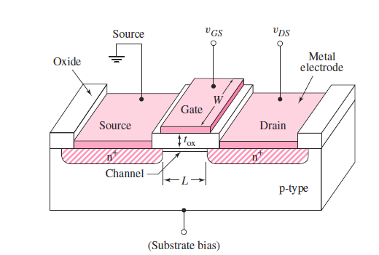
N Channel-MOSFET Structure
The channel length of a typical integrated circuit MOSFET is less than 1 μm (10⁻⁶ m), which
means that MOSFETs are small devices.
The oxide thickness t_{ox} is typically on the order of 400 angstroms, or less.

Slide 7
Enhancement Mode MOSFET

Slide 8
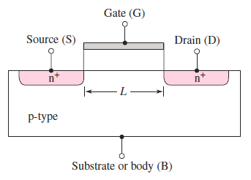
With zero bias applied to the gate, the source and drain terminals are separated by the p-region, as shown in Figure
The current in this case is essentially zero.
If a large enough positive gate voltage is applied, an electron inversion layer is created at the oxide–semiconductor interface and this layer “connects” the n-source to the n-drain
A current can then be generated between the source and drain terminals.
Since a voltage must be applied to the gate to create the inversion charge, this transistor is called an enhancement-mode MOSFET.
Since the carriers in the inversion layer are electrons, this device is also called an n-channel
MOSFET (NMOS).

Slide 9
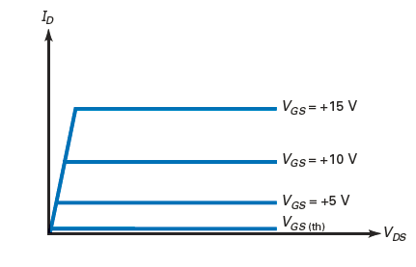
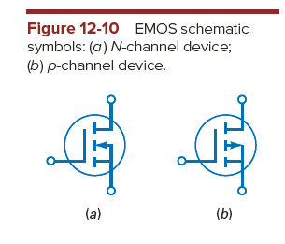
The minimum V_{GS}that creates the n-type inversion layer is called the threshold voltage, symbolized by V_{GS}(th).
When V_{GS} is less than V_{GS}(th), the drain current is zero
When V_{GS} is greater than V_{GS}(th), an n-type inversion layer connects the source to the drain and the drain current can flow
Typical values of V_{GS}(th) for small-signal devices are from 1 to 3 V.

Slide 10
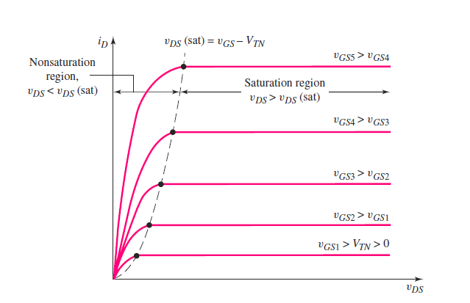

Slide 11
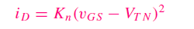
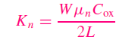
Drain Current in the Saturation Region
Conduction Parameter

Slide 12
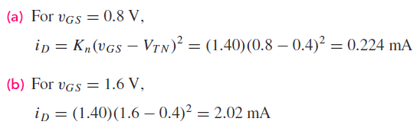
Consider an n-channel enhancement-mode MOSFET with the following parameters:
V_{T N} = 0.4 V, K_{n} = 1.40 mA/V²
Determine the current when the transistor is biased in the saturation region for (a) V_{GS} = 0.8 V and (b) V_{GS} = 1.6 V

Slide 13
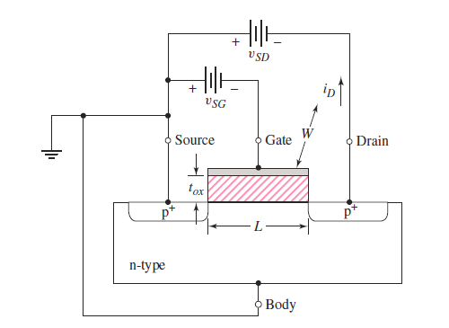
P- Channel MOSFET

Slide 14
The operation of the p-channel device is the same as that of the n-channel device, except the hole is the charge carrier rather than the electron.
A negative gate bias is required to induce an inversion layer of holes in the channel region directly under the oxide. The threshold voltage for the p-channel device is denoted as V_{TP}.
Since the threshold voltage is defined as the gate voltage required to induce the inversion layer, then V_{TP} < 0 for the p-channel enhancement-mode device.

Slide 15
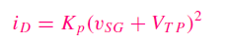
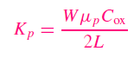
Drain Current in the Saturation Region
Current
Conduction Parameter

Slide 16
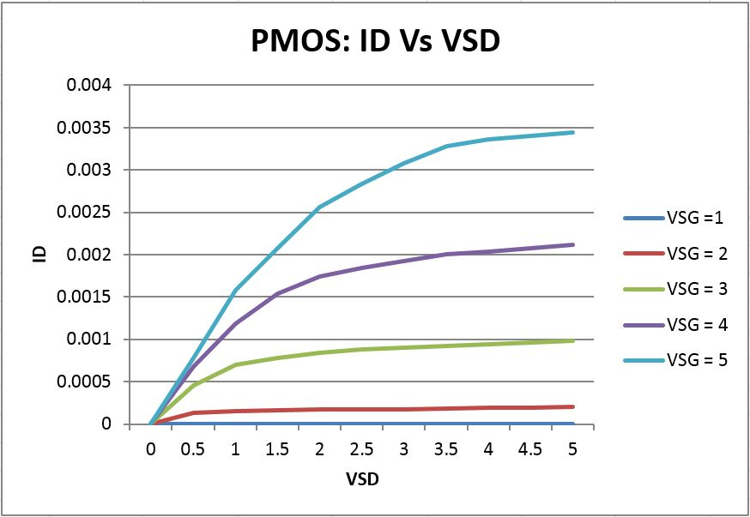
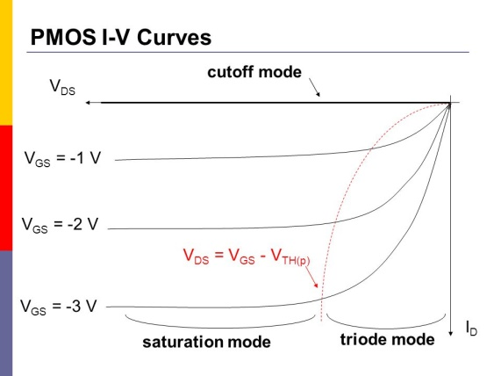
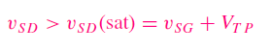
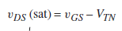

Slide 17
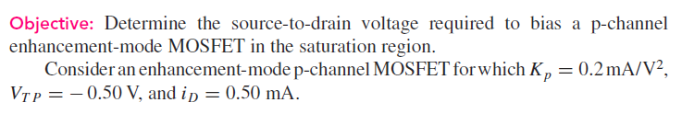
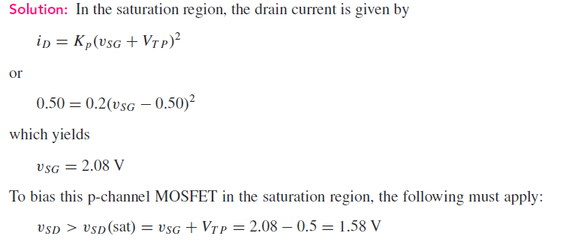

Slide 18
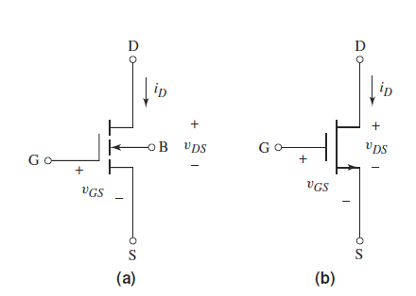
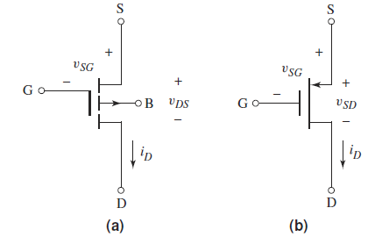
Circuit Symbols
N Channel Enhancement mode
P Channel Enhancement mode

Slide 19
Depletion mode of operation

Slide 20
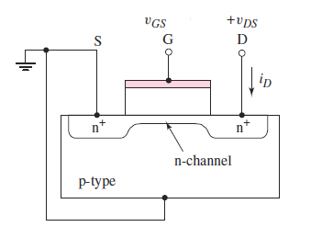
n-Channel Depletion-Mode MOSFET- Construction

Slide 21
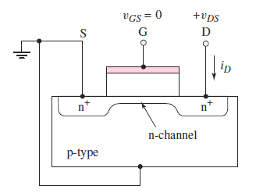
n-Channel Depletion-Mode MOSFET- Operation
Case 1: When zero volt is applied to the gate, an n-channel region or inversion layer exists under the oxide
Since an n-region connects the n-source and n-drain, a drain-to-source current may be generated in the channel even with zero gate voltage
The term depletion mode means that a channel exists even at zero gate voltage

Slide 22
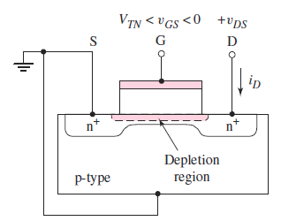
Case 2: A negative gate voltage must be applied to the n-channel depletion-mode MOSFET to turn the device off
A negative gate voltage induces a space-charge region under the oxide, thereby reducing the thickness of the n-channel region
The reduced thickness decreases the channel conductance, which in turn reduces the drain current

Slide 23
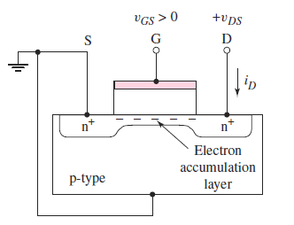
Case 3: A positive gate voltage creates an electron accumulation layer, as shown in Figure which increases the drain current

Slide 24
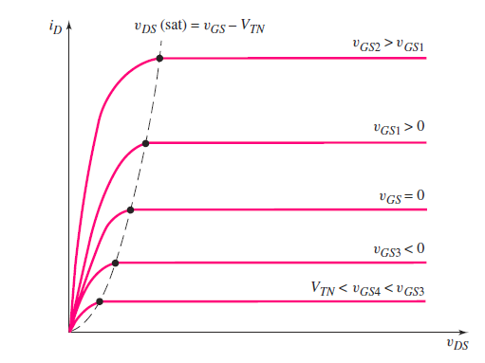
I_{D} - V_{DS} curves

Slide 25
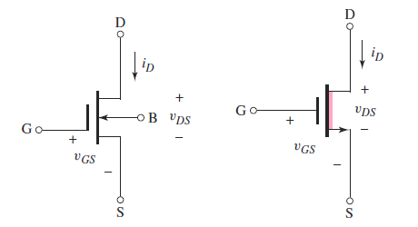
Circuit Symbol

Slide 26
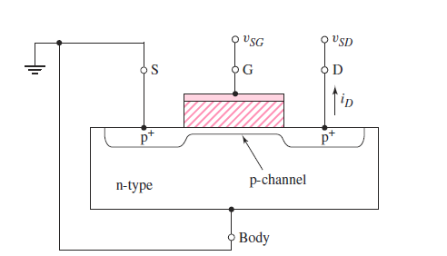
P- Channel Depletion mode MOSFET
In the depletion-mode device, a channel region of holes already exists under the oxide, even with zero gate voltage
A positive gate voltage is required to turn the device off
The threshold voltage of a p-channel depletion-mode MOSFET is positive (V_{TP} > 0).

Slide 27
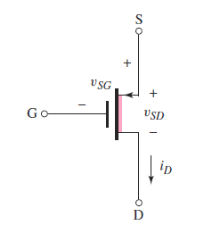
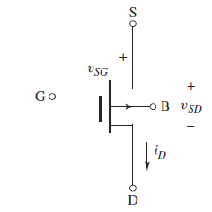
Circuit Symbol

Slide 28
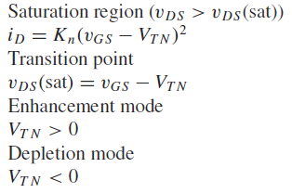
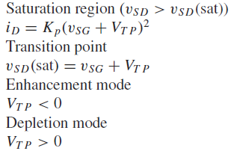
Summary
NMOS
PMOS

Slide 29
Configurations of MOSFET
Common Source
Common Gate
Common Drain

Slide 30
MOSFET Biasing
An essential step in the design of a MOSFET amplifier circuit is the establishment of an appropriate dc operating point for the transistor.
This step is also known as biasing or bias design.
An appropriate DC operating point or bias point is characterized by a stable and predictable dc drain current ID and by a dc drain-to-source voltage V_{DS} that ensures operation in the saturation region for all expected input-signal levels.
Types of Biasing: – Biasing by Fixing V_{GS} – Biasing by Fixing V_{G} and Connecting a Resistance in the Source – Biasing Using a Drain-to-Gate Feedback Resistor – Biasing Using a Constant-Current Source

Slide 31
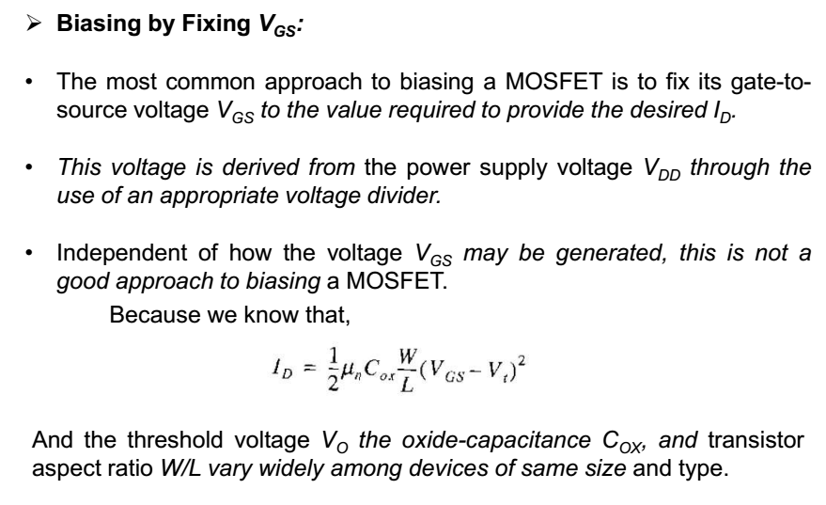
MOSFET Biasing

Slide 32
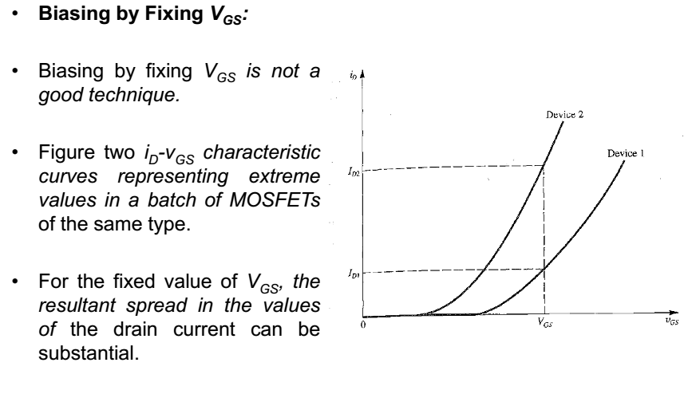
MOSFET Biasing

Slide 33
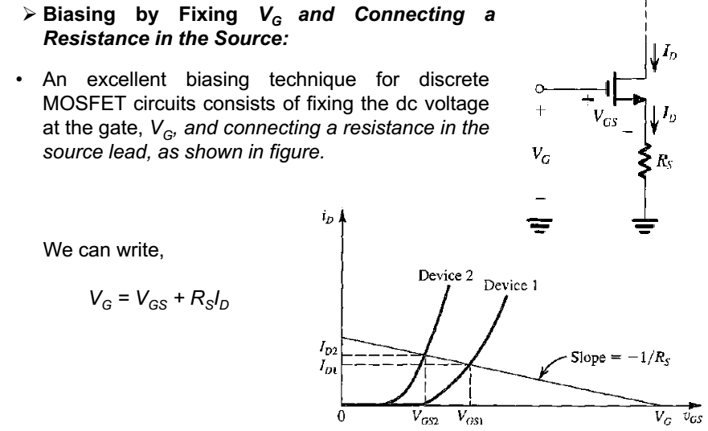
MOSFET Biasing

Slide 34
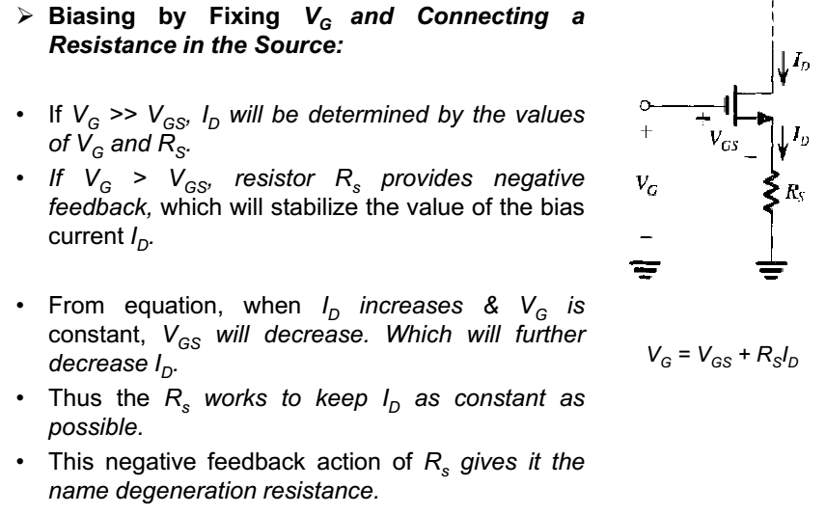
MOSFET Biasing

Slide 35
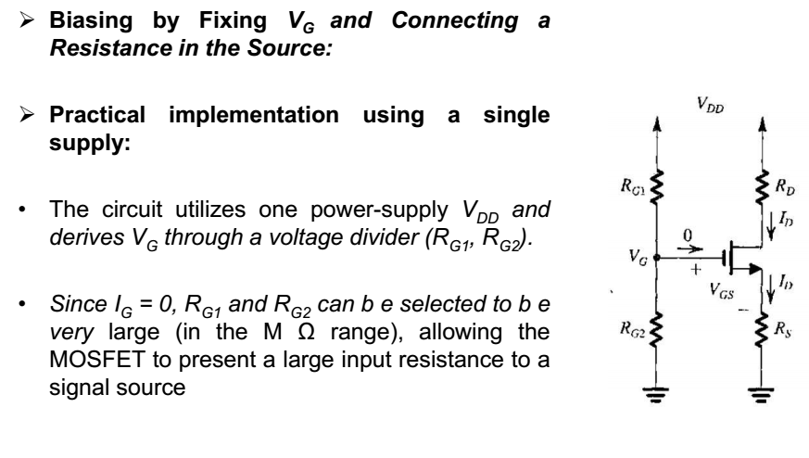
MOSFET Biasing

Slide 36
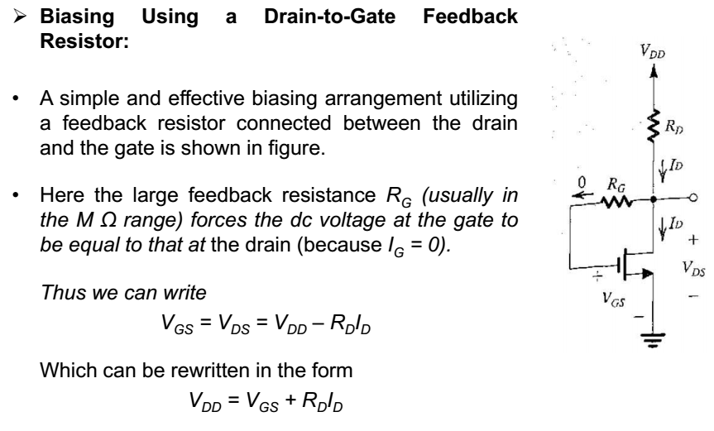
MOSFET Biasing

Slide 37
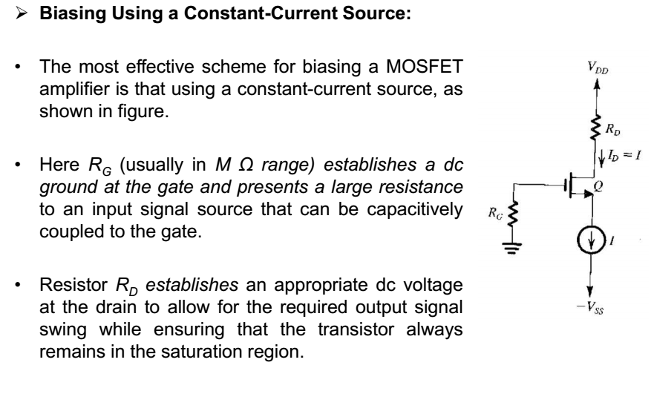
MOSFET Biasing

Slide 38
SMALL-SIGNAL ANALYSIS
OF MOSFET

Slide 39
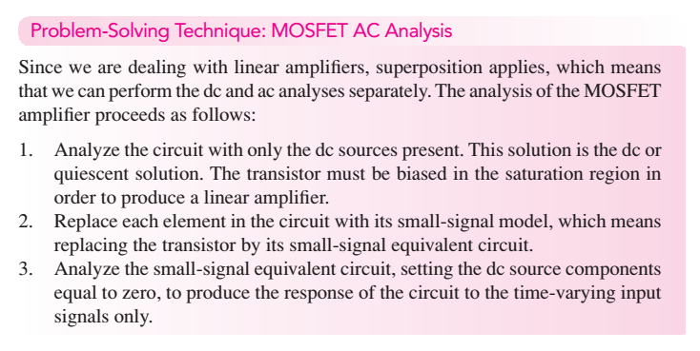

Slide 40
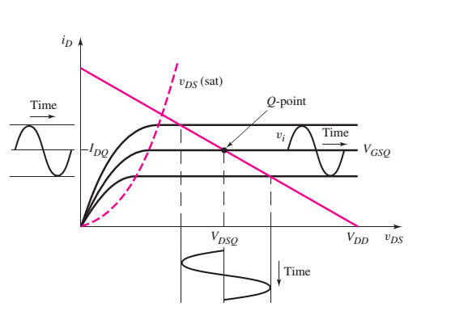
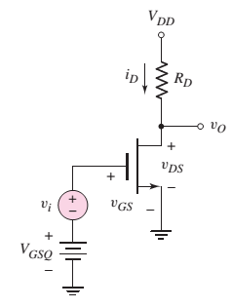
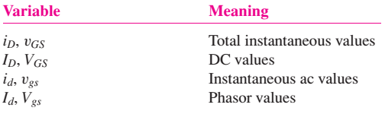
THE MOSFET AMPLIFIER
(a) NMOS common source configuration
(b) Common-source transistor characteristics

Slide 41
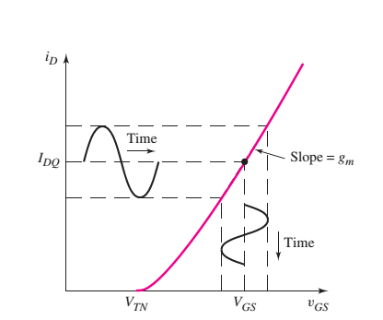
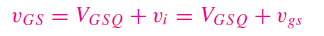
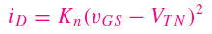
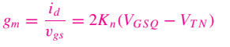
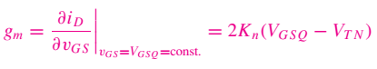
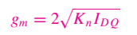
Drain current versus gate-to-source voltage characteristics, with superimposed sinusoidal signals

Slide 42
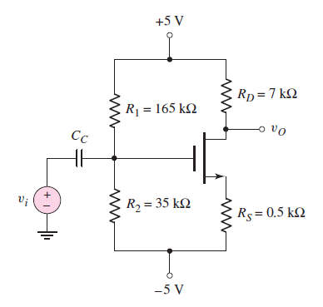
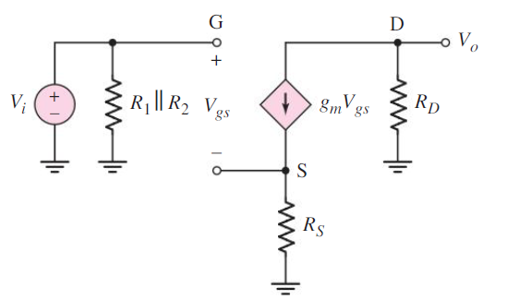
Common-Source Amplifier with Source Resistor

Slide 44
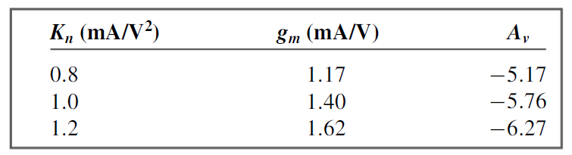

Slide 45

Common-Source Amplifier with Source Bypass capacitor

Slide 46



Slide 47

THE COMMON-DRAIN (SOURCE-FOLLOWER) AMPLIFIER

Slide 48

Small Signal Voltage Gain

Slide 49






Slide 50

Common Source with output coupling capacitor

Slide 51


Slide 52


Slide 53


Slide 54

Miller Effect & Miller Capacitance

Slide 55


Slide 56



Slide 57


